Slide 1

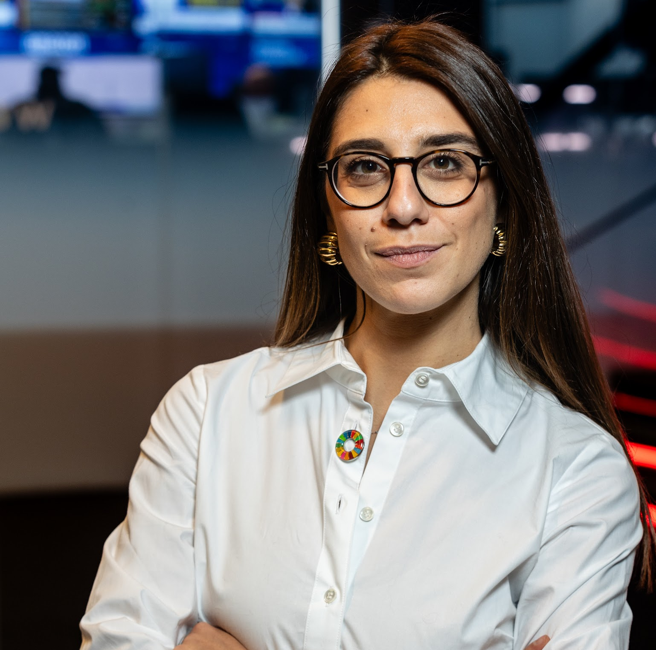
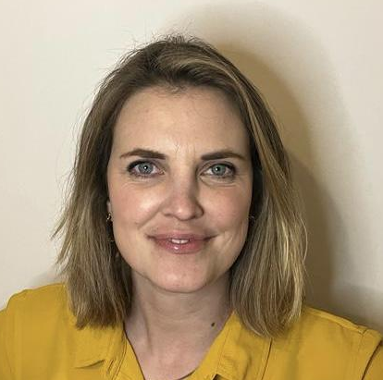
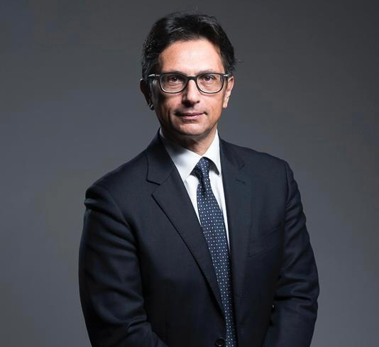
United Nations Global Compact and GAIL
14 October, 4:40 PM - 5:00 PM CDMX
Rubinia Proli
Legal Council Senior Advisor
United Nations Global Compact
Roberto Randazzo
Partner
Legance
#GAILSummit
CONNECT. LEARN. LEAD

Slide 2

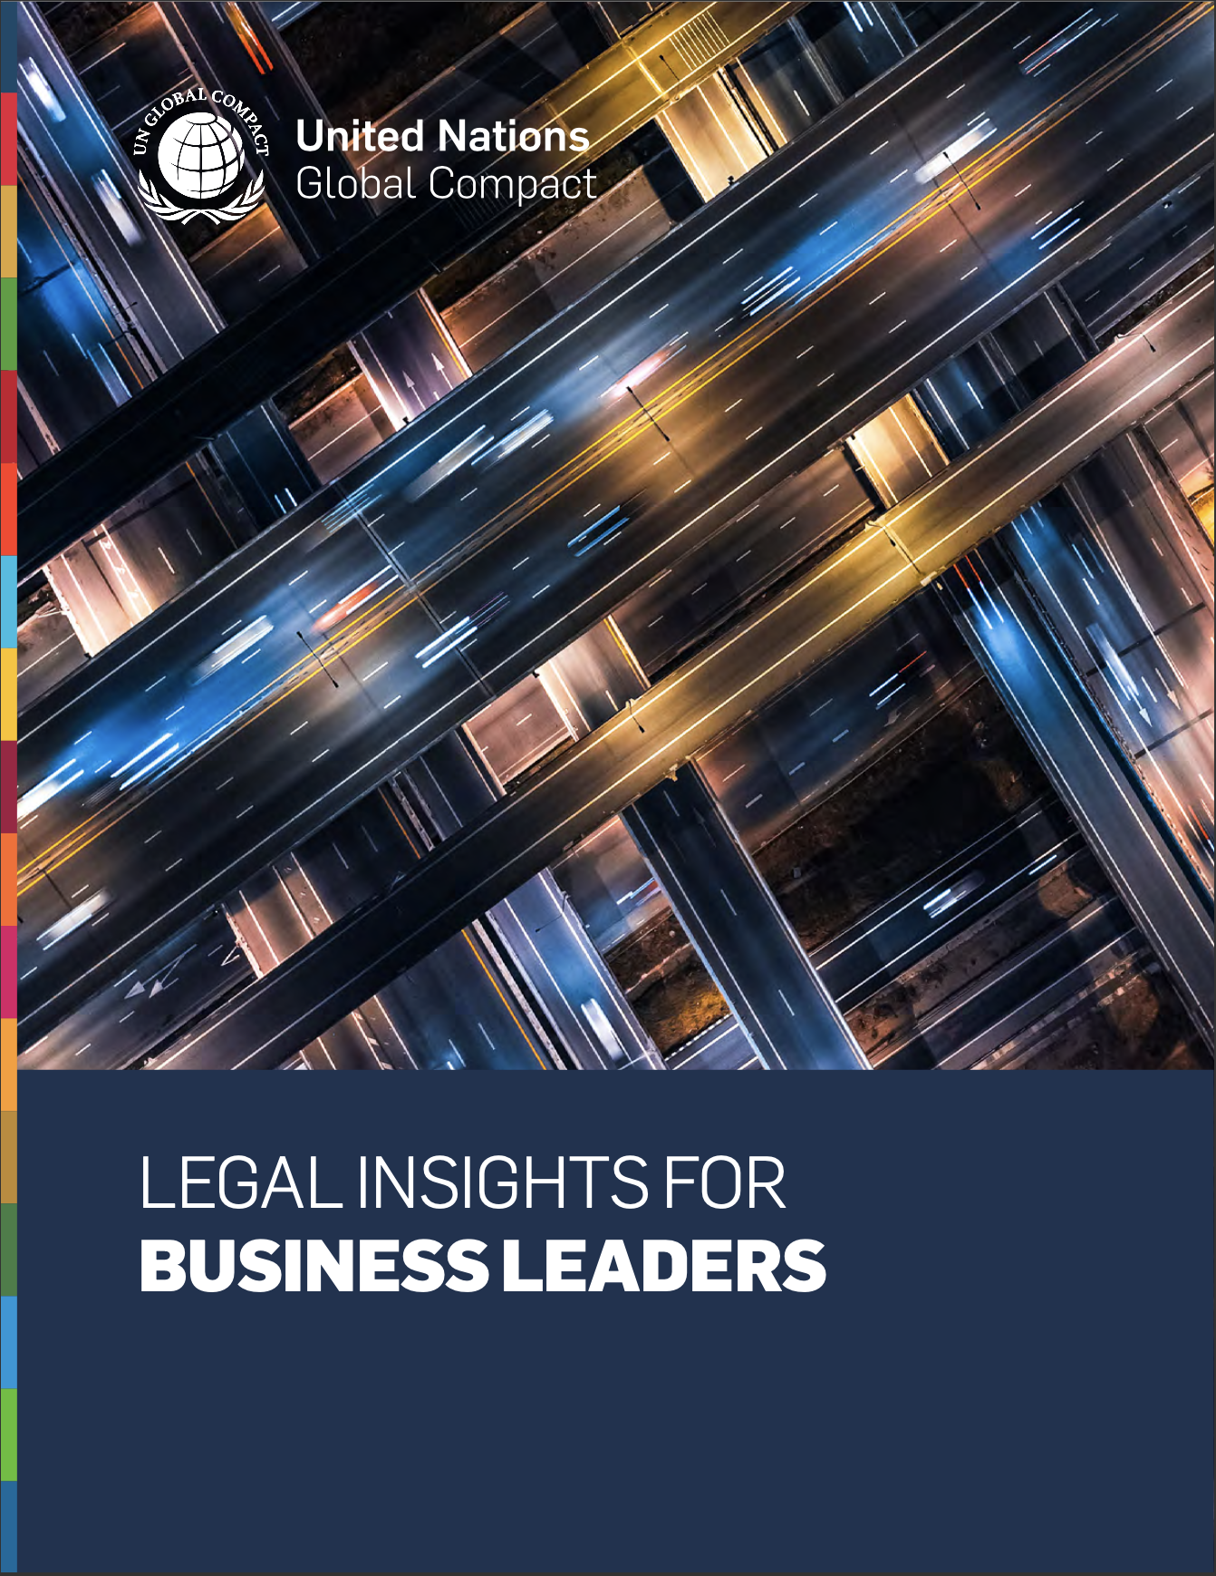

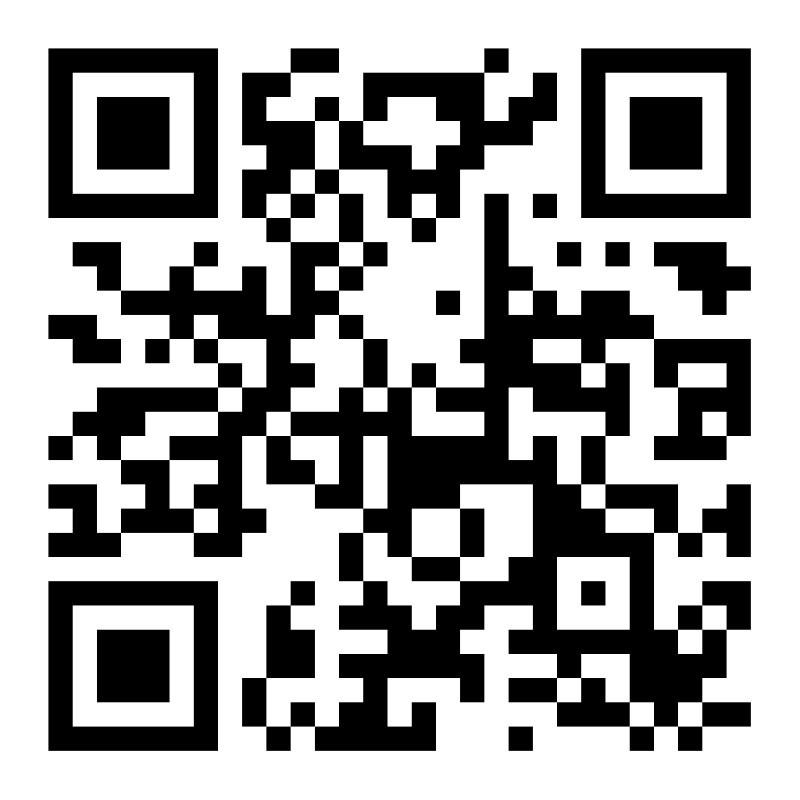

Notes:
To help us navigate this new reality, we developed the “Legal Insights for Business Leaders” report. This report outlines how the accelerating pace of policy and regulation is reshaping business, creating both significant risks and new opportunities worldwide. This report is quite unique because it was shaped through collaboration with legal experts across jurisdictions and the UN Legal Council, and it captures a truly global perspective on the evolving ESG landscape.
It is structured into three key sections to provide a comprehensive guide for business leaders.
First, it explores Navigating the Rapid Evolution of Global ESG Regulation, outlining the speed, complexity, and global reach of these changes.
Secondly, it provides Legal Insights with concrete examples and actionable advice from legal professionals across various jurisdictions.
And third, it highlights how The UN Global Compact provides guiding frameworks and tools to help businesses lead with integrity.

Slide 3
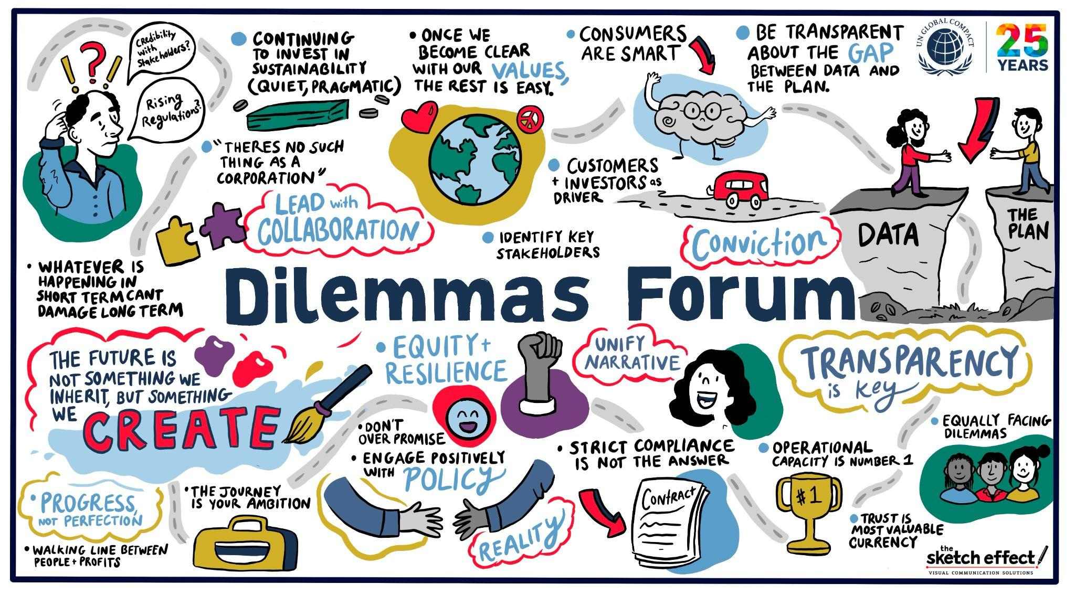
Notes:
As you can see [point] from the live digital illustration resulting from the table discussion, themes like equity, resilience, transparency, collaboration, and trust were voiced directly by business leaders. The report builds on that dialogue. It translates those reflections into actionable guidance, so that legal teams and executives can not only navigate fragmented regulation but also turn it into a source of resilience and competitive strength.

